Slide 1
INHERITANCE
IN
PYTHON

Slide 2
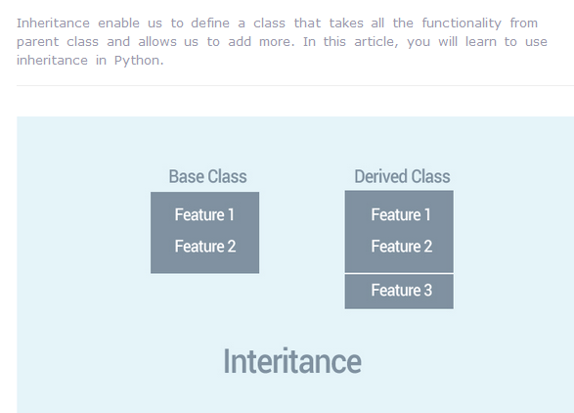

Slide 3
Instead of starting from scratch, you can create a class by deriving it from a preexisting class by listing the parent class in parentheses after the new class name.
The child class inherits the attributes of its parent class, and you can use those attributes as if they were defined in the child class. A child class can also override data members and methods from the parent.

Slide 4
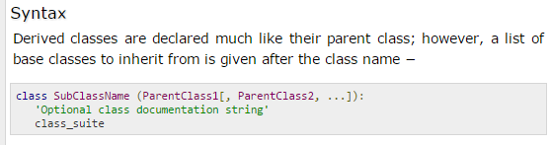
The Syntax is:

Slide 5
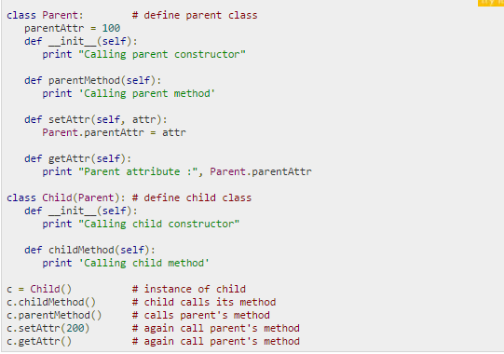

Slide 6
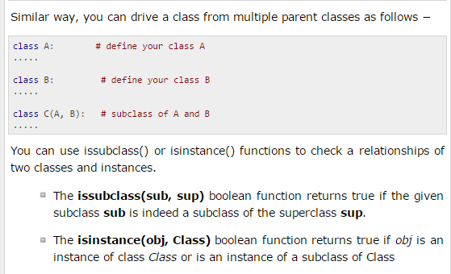

Slide 7
Overriding Methods
You can always override your parent class methods. One reason for overriding parent's methods is because you may want special or different functionality in your subclass.

Slide 8
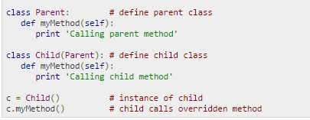
Example

Slide 9
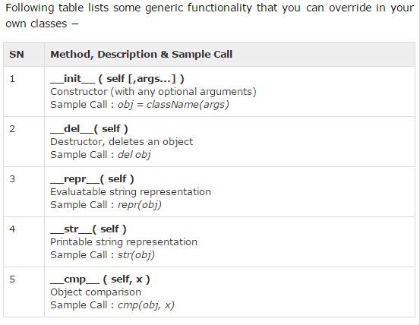
Base Overloading Methods

Slide 10
Overloading Operators
Suppose you have created a Vector class to represent two-dimensional vectors, what happens when you use the plus operator to add them? Most likely Python will yell at you.
You could, however, define the __add__ method in your class to perform vector addition and then the plus operator would behave as per expectation

Slide 11
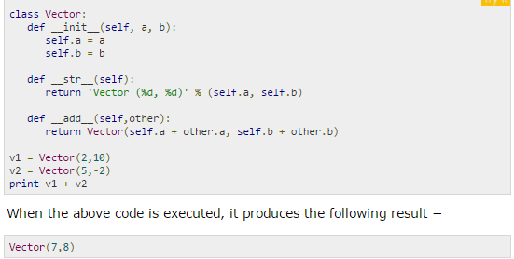
Example

Slide 12
Data Hiding
An object's attributes may or may not be visible outside the class definition. You need to name attributes with a double underscore prefix, and those attributes then are not be directly visible to outsiders.

Slide 13
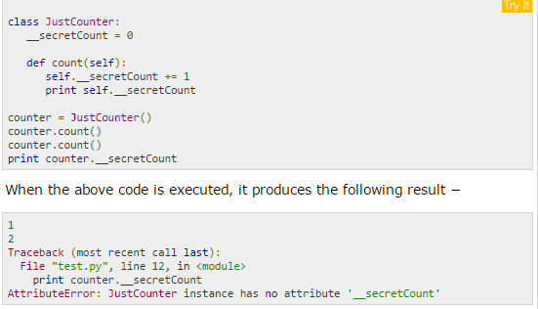

Slide 14
